Slide 1

iHealthBuddy
Online Public Healthcare Portal under HSE for easy appointment booking and retrieving medical records

Slide 2


Scenario
Long wait times
Staffing shortages
Lack of integration between primary and secondary care

Slide 3
Our Services
Electronic medical records
Appointment Scheduling
Online referring of specialists by general practitioners or specialists

Slide 4


Value Proposition
1.
Makes Public healthcare more appealable to the public, patients feel valued and get to choose their consultant
2.
Proper scheduling reduces patient wait time and allows front desk staff to focus on other activities.
3.
Makes the process seamless by integrating secondary and primary care
4.
Can use customer data to make smart decisions.

Slide 5
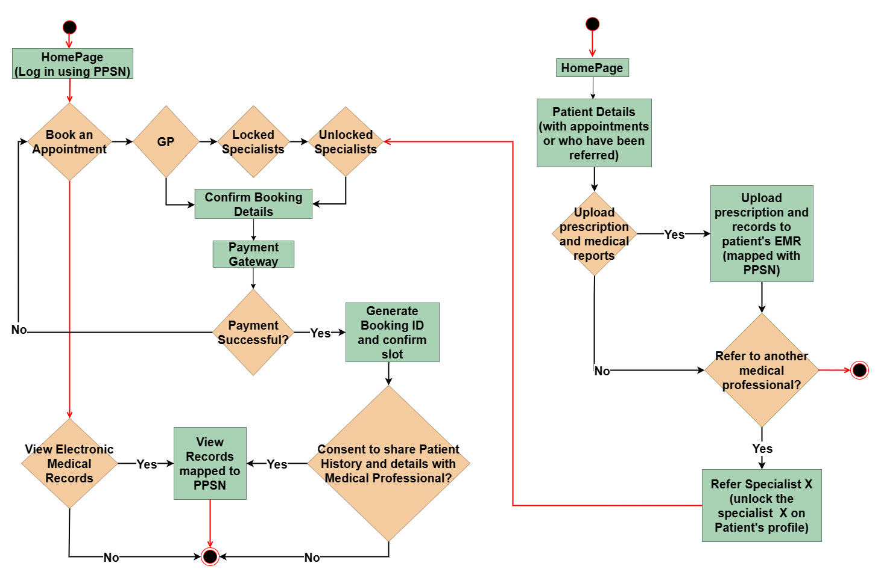
Patient’s View
Healthcare Provider’s View
Process Flow Diagram

Slide 6

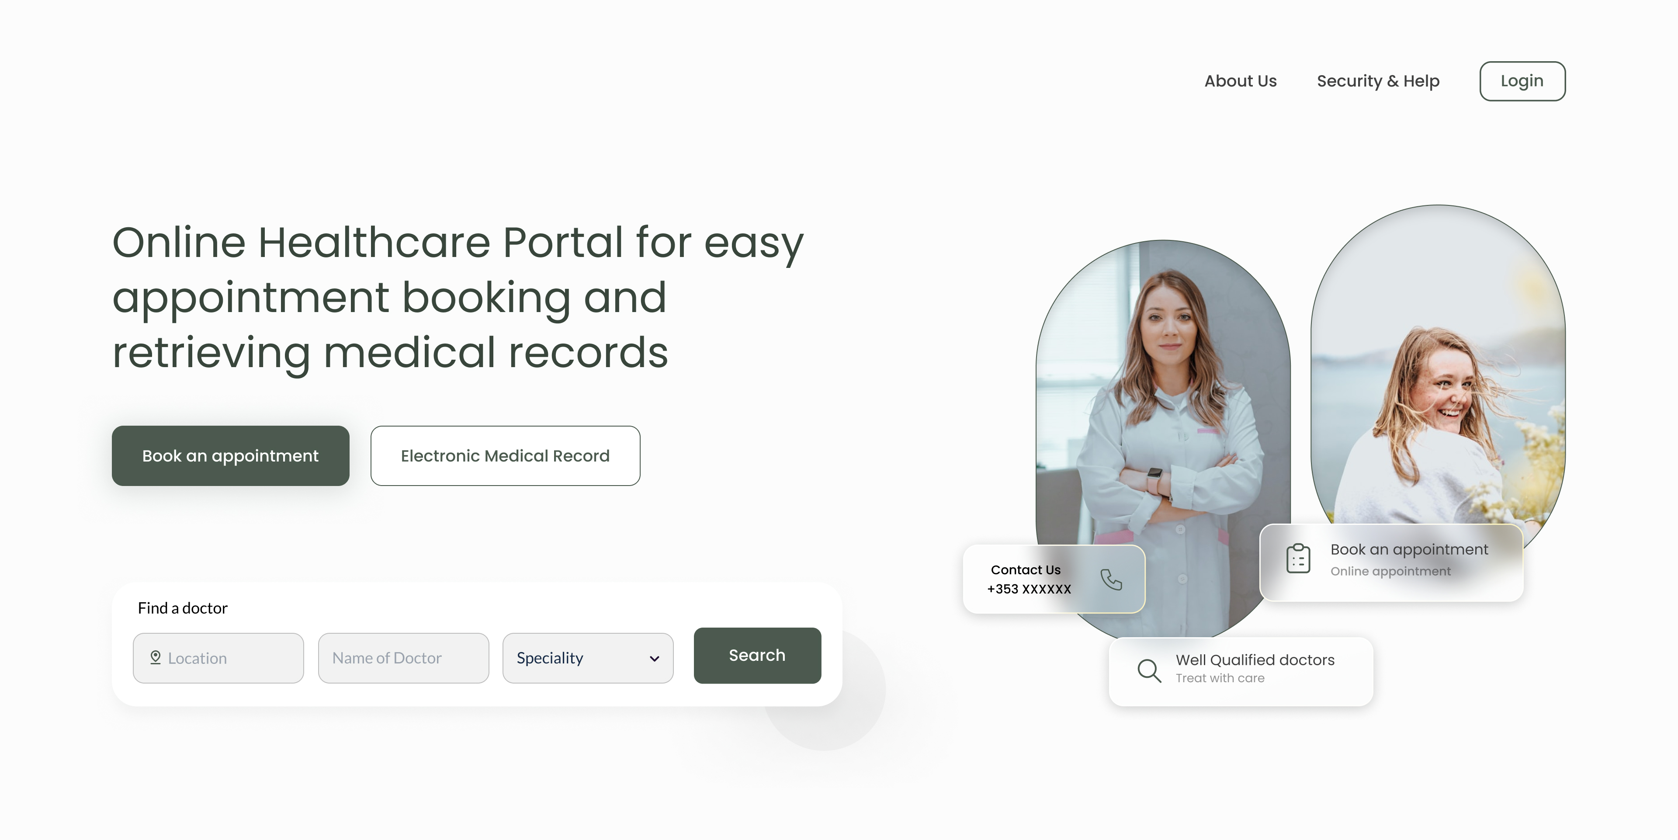
Landing Page

Slide 7
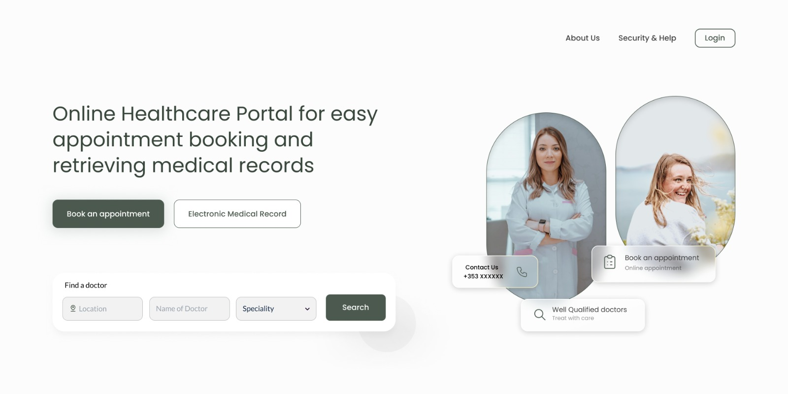



Process Architecture
Web Application
Irish Healthcare Backend Server
Cloud Server
Doctors/ Medical Practitioners
Payment Provider
Users / Patients

Slide 8


Future Scope
Online Video Consulting
AI Chatbot
Reminders of regular health screenings and checkups
Online ordering and delivery of medicines
Mobile App

Slide 9

THANK YOU!
By:
Anushka Jain – 22200246
Akhilesh Kapoor – 22201803
Disha Shetty - 22200931

